Slide 1
Teamtreffen 25.07
Notes:
31.07.2023
1
1

Slide 2

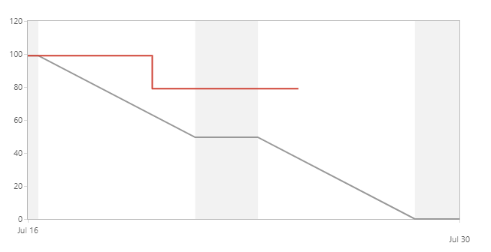
Burndown Sprint 1 v4

Slide 3
Sprint 1 v4 Entwicklung
Sylvan:
Leon:
Ali:
Jonas:
Luis:
Celina:
Armin:
Multiple own Monster
Fast travel & Mirrored Tiles & Networking
Jumpable Tiles & Refactoring
Mondex
Shop & Inventar
End Fight
Doku
Notes:
31.07.2023
3
3

